Slide 1

Name : Neha Pallavi . M
Reg_no : 18030141CSE007

Slide 2
CONTENT
Network Traversal:
Euler graphs
The Chinese Postman Problem
Hamilton cycles
Properties of Hamiltonian graphs
finding a Hamilton cycle
optimal Hamilton cycles

Slide 3
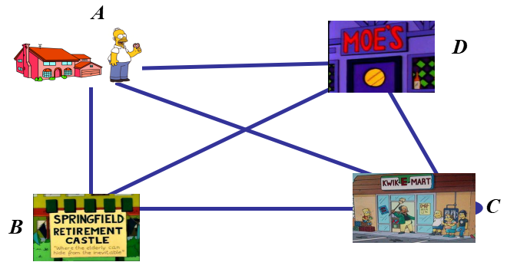
Euler graph :
Euler Circuit : An Euler Circuit in a graph is a circuit which uses every edges of the graph exactly once
EXAMPLE : TRAVELING SALESMAN
From home, the traveling salesman must visit different destinations to sell goods and return home. This is essentially finding a Euler Circuit.
Pradeep, he has to run at the Kwik-E-Mart, the Retirement Home and Moe`s. Assuming that he wants to begin and end his day at home find the route that will allow him to get back to home as soon as possible.
A
D
Result : A-C-B-D-A
C

Slide 4
Chinese Postman Problem
A Hamiltonian path, also called a Hamilton path, is a graph path between two vertices of a graph that visits each vertex exactly once.
EXAMPLE : Glocery Shopping
Result : A-B-C-D-E-A
If a Hamiltonian path exists whose endpoints are adjacent, then the resulting graph cycle is called a Hamiltonian cycle (or Hamiltonian cycle).
EXAMPLE :
(B)
Vegetable section
(A)
Person
D(c(C)
((Diary products
(E)
Home appliances
((D)
fFruits section
1
1-2-3-4-1
1-4-3-2-1
1-3-4-2-1
2
4
3

Slide 5
APPLICATIONS : Garbage collection , clearing snow
Sufficient Condition :
Dirac’s Theorem : If G is a simple graph with n vertices (n>=3) such that every vertex degree in G is atleast n/2
Then G has Hamiltonian cycle.
Example :
P
n = 4 , then n/2 = 2
S
Q
R
2) ORE’S Theorem : If G is a simple graph with n vertices (n>=3) such that deg(u) + deg(v) >=n for every pair of non-adjacent vertices u and v in G then G has a Hamiltoninan Cycle.
Example :
1
5
2
4
3

Slide 6
OPTIMAL PATH :
In graph theory, the shortest path problem is the problem of finding a path between two vertices (or nodes) in a graph such that the sum of the weights of its constituent edges is minimized.
ALGORITHM
Step 1 : List all odd vertices.
Step 2 : List all possible pairing of odd vertices.
Step 3 : For each pairing find the edges that connect with minimum weights
Step 4 : For each pairings such that the sum of the weights is minimised.
Step 5 : On the Original graph add the edges that have been found in Step 4.
Step 6 : The length = sum of the weights of all the edges.
Step 7 : A route Corresponds to this minimum weight can be easily found.

Slide 7
EXAMPLE : Choose the optimal path for the given graph using Chinese postman problem
1
Step 1 : The two odd vertices are A and C
Step 2 : AC
Path : 1) A-B-C = 6
2) A-C = 4
3) A-D-C = 11
Step 3 : A-C = 4 Minimum Path
Step 4 : The minimum path from A to C
A-C = 4
Step 5 :
A
B
4
3
5
D
C
9
Step 6 : weight = 22
A
1
B
4
3
4
5
D
C
9
Step 7 : A-B-C-A-D-C-A
Total weight = 22 + 4 = 26

Slide 8
POSA Algorithm

